Slide 1





Experiential Learning Session on Foundation Models for Geoscience
Manil Maskey, PhD
Office of Data Science and Informatics (ODSI)
NASA, Marshall Space Flight Center
Lifecycle of Large-Scale AI Models in the Cloud: A Focus on Deploying and Fine-Tuning Geospatial Foundation Models
IGARSS 2025
June 23, 2025

Slide 2

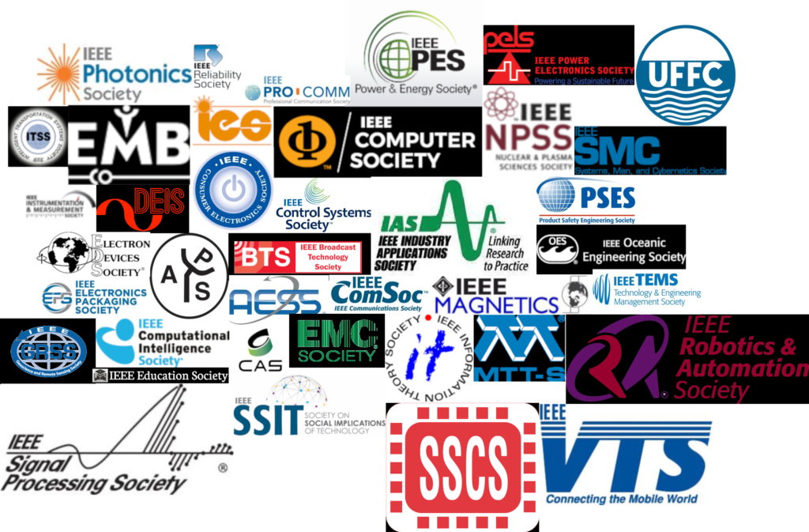
The largest academic and professional Society with ~430,000 members in 160 countries
https://www.ieee.org/

Slide 3






Location: All over the world
Beginnings: Founded in 1961
Mission: One of 39 IEEE Technical Societies. Fosters engagement for the benefit of society through science, engineering, applications, and education related to geoscience and remote sensing
https://www.grss-ieee.org/
Scope: Includes theory, concepts, and techniques of remote sensing of the Earth, oceans, atmosphere, and space, as well as processing, interpretation, and dissemination of this information
Members: ~5,000 members in 94 countries
Chapters: 69 chapters, 22 student chapters, and 11 ambassadors all over the world

Slide 4
IEEE
Geoscience and Remote Sensing Society (GRSS)
Conferences
Education
Publications
Professional
Activities
Technical
Activities

Slide 5


IEEE
Geoscience and Remote Sensing Society (GRSS)
Join GRSS
Subscribe to the GRSS eNewsletter

Slide 6





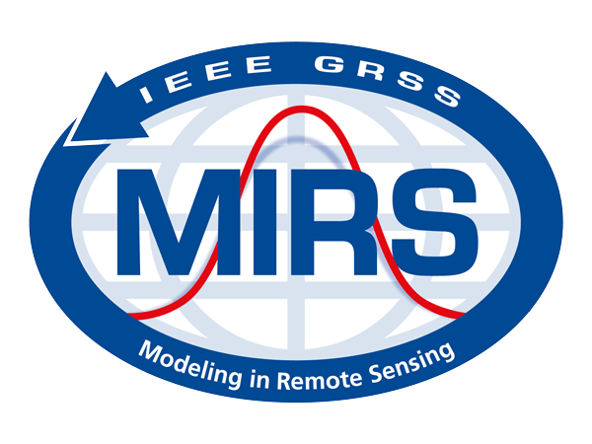


IEEE
GRSS Technical Committees
Earth Science Informatics
Quantum Earth Science and Technology
Frequency allocations
in Remote Sensing
Objective: Advance application of informatics to geoscience and remote sensing
Geoscience Spaceborne
Imaging Spectroscopy
Image Analysis and
Data Fusion
Exchange ideas and share knowledge
Advance application of informatics to geosciences and remote sensing
Assessing technology to support data stewardship and management
Promote best practices and lessons learned
Instrumentation and Future
Technologies
Modeling in Remote Sensing
Remote sensing Environment,
Analysis and Climate Technologies
GRSS Standards for
Earth Observations
https://www.grss-ieee.org/technical-committees/earth-science-informatics/

Slide 7














ESI TC Leadership
GRSS
TC Chair/Co-chairs
HDCRS WG Leads
RSDS WG Leads
Earth² WG Leads
Past-Chair
TC Secretary
Manil Maskey
Dora Blanco Heras
Muthukumaran Ramasubramanian
Sujit Roy
Peter Baumann
Jerika (Christman) Chung
Chair-elect
Rocco Sedona
Kesheng Wu
Rajat Shinde
Gabriele Meoni
Iksha Gurung
Sujit Roy
Sudan Jha
Khalid Belhajjame
Johannes Schmude

Slide 8

https://www.grss-ieee.org/technical-committees/earth-science-informatics/

Slide 9
ESI Tutorial
Goals of the tutorial
Continue building capacity around data science
Explore research and applications of Foundation Models for Earth Observation
Provide hands on experience to support research and application lifecycle:
Use of Cloud Computing Platform (AWS) to
Fine-tune geospatial foundational models
Deploy and infer from a trained model
Provide forum to exchange Ideas
Foster collaboration

Slide 10
Foundation Models for EO
Contributions from:
Dr. Rahul Ramachandran, AI Lead, ODSI/OCSDO
Dr. Sujit Roy, AI Scientist, ODSI
June 23, 2025

Slide 11
AI Foundation Model for Science
Supervised learning
Curate Labeled Data
Train Model
Deploy Model
Notes:
Much of the progress in general and in NASA - SL applications

Slide 12
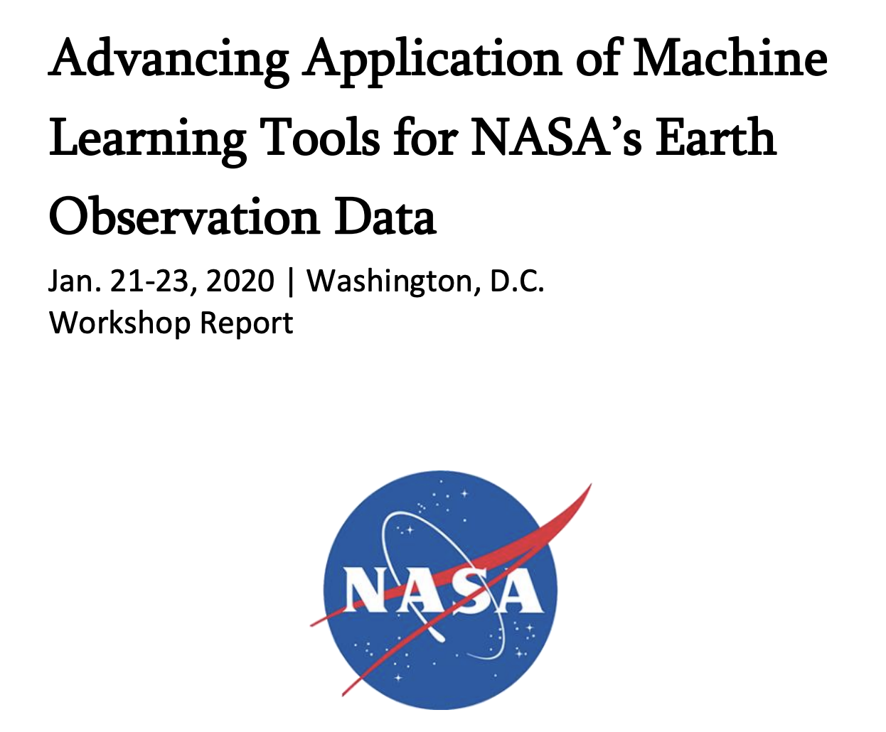
AI challenges in Earth science
Training data is the main component of supervised machine learning techniques and is increasingly becoming the main bottleneck to advance applications of machine learning techniques in Earth science.
Geoscience models must generalize across space and time; however, for supervised learning one needs large training datasets to build generalizable models.
Maskey et al. “Advancing AI for Earth Science: A Data Systems Perspective,” AGU Eos 2020

Slide 13
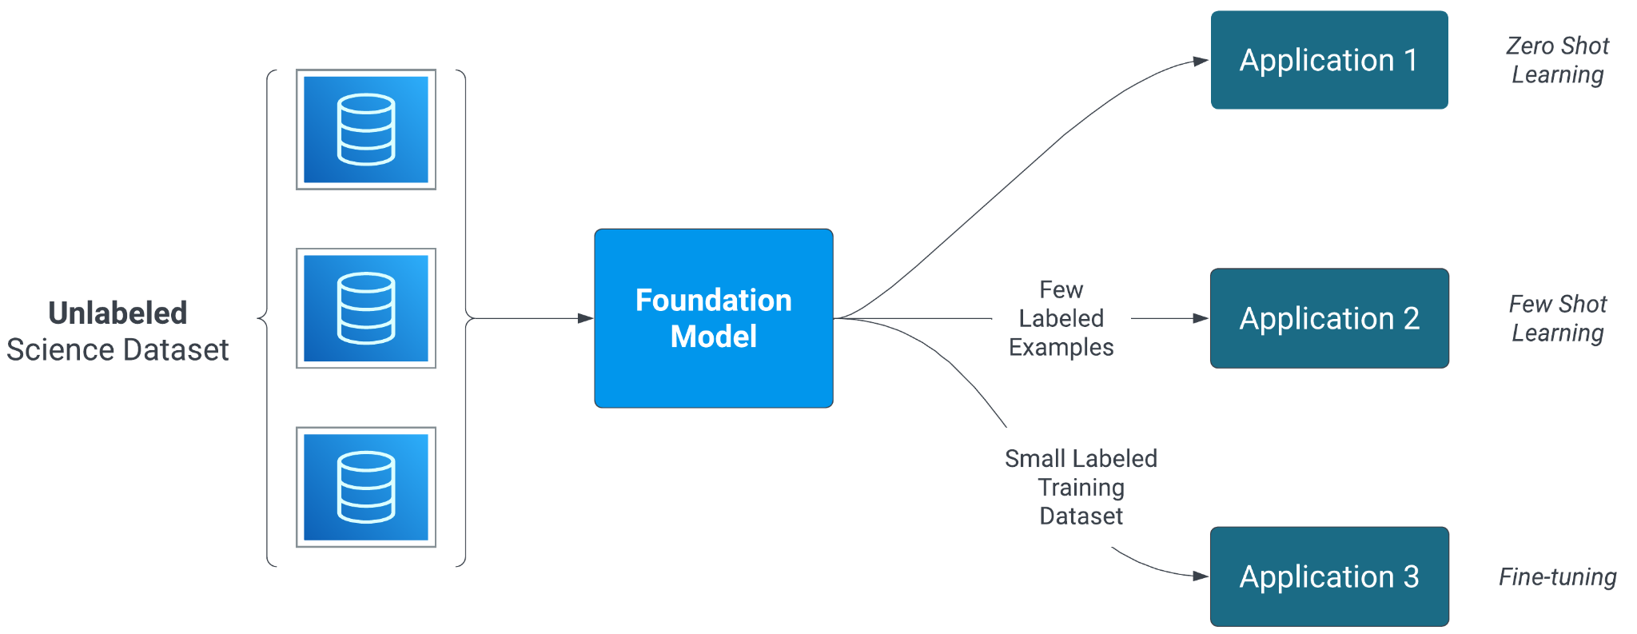
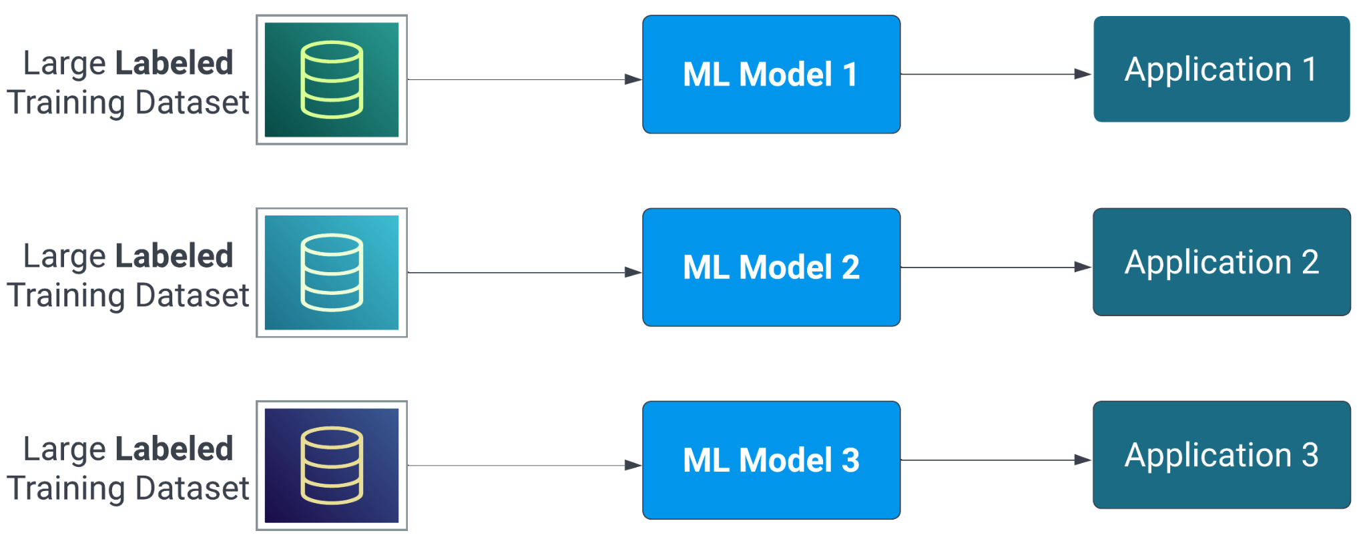
AI Foundation Models
Traditional Supervised Learning Approach
Foundation Model Approach
An AI Foundation Model is a large machine learning model pre-trained on a vast amount of data using self supervision, enabling it to perform a wide range of tasks.
Advantages
Maximizes the potential of archives of time series datasets
Reduces effort for building AI applications
A single foundation model can be fine-tuned for a wide range of applications
Foundation models often achieve state-of-the-art performance on various tasks, even with limited labeled data

Slide 14
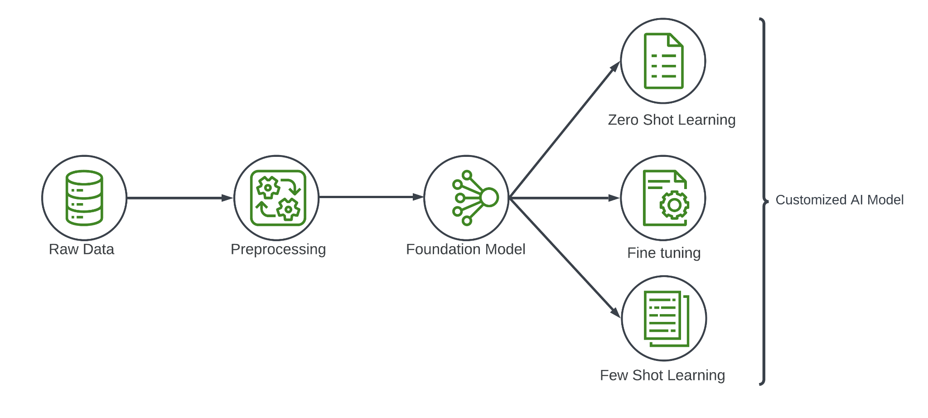
AI Foundation Model for Science
Why Build Foundation Models?
Many individual researchers
Collaborations
Small dataset
Reduced data and resource needs for custom models

Slide 15
AI foundation Model for Science
Changing paradigm
Supervised learning
Curate Labeled Data
Train Model
Deploy Model
Tuning on smaller data
Develop Prompts
Deploy Model

Slide 16
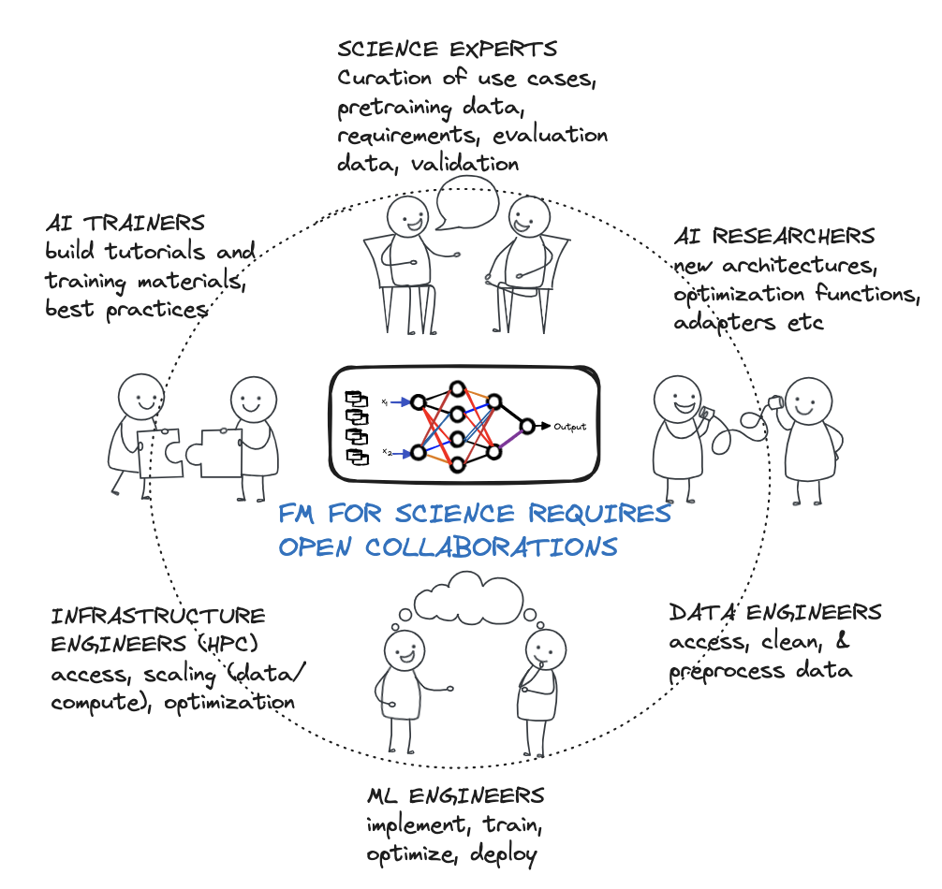
AI foundation Model for Science
Building These FM Requires OPEN Collaborations
Diverse skill sets are required to build a useful AI FM (beyond just writing a paper)
Compute resources
Access to data
Difficult for a single team/organization to do this well for science

Slide 17















Research
Collaborations

Slide 18
AI for Science
OCSDO AI Strategy
Data-Driven Predictive Modeling and Simulation
Develop data driven predictive modeling and simulation to forecast phenomena and help in understanding and planning impacts of various phenomena
Enhancing the Scientific Process
Improve scientific efficiency by advancing tools for data search, discovery, analysis, and visualization
Collaboration and AI Literacy
Promote interdisciplinary collaboration by integrating data across missions and domains to support systems-level science
Encourage partnerships between domain experts and AI practitioners
Foundational AI Infrastructure
Establish a secure, scalable infrastructure to support AI model development, deployment, and integration

Slide 19
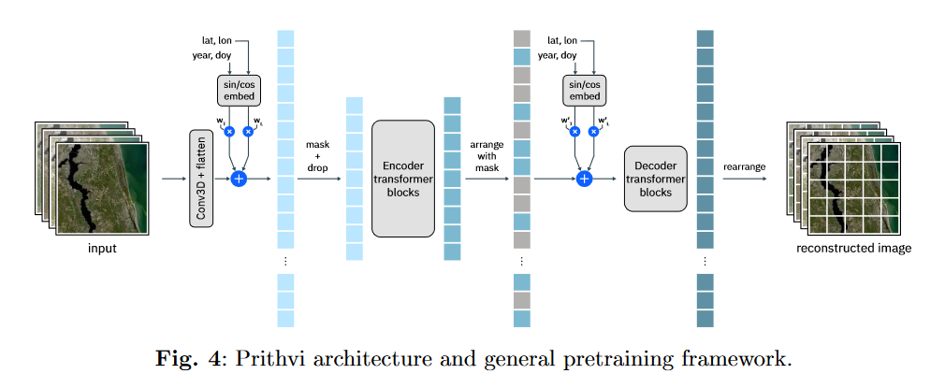
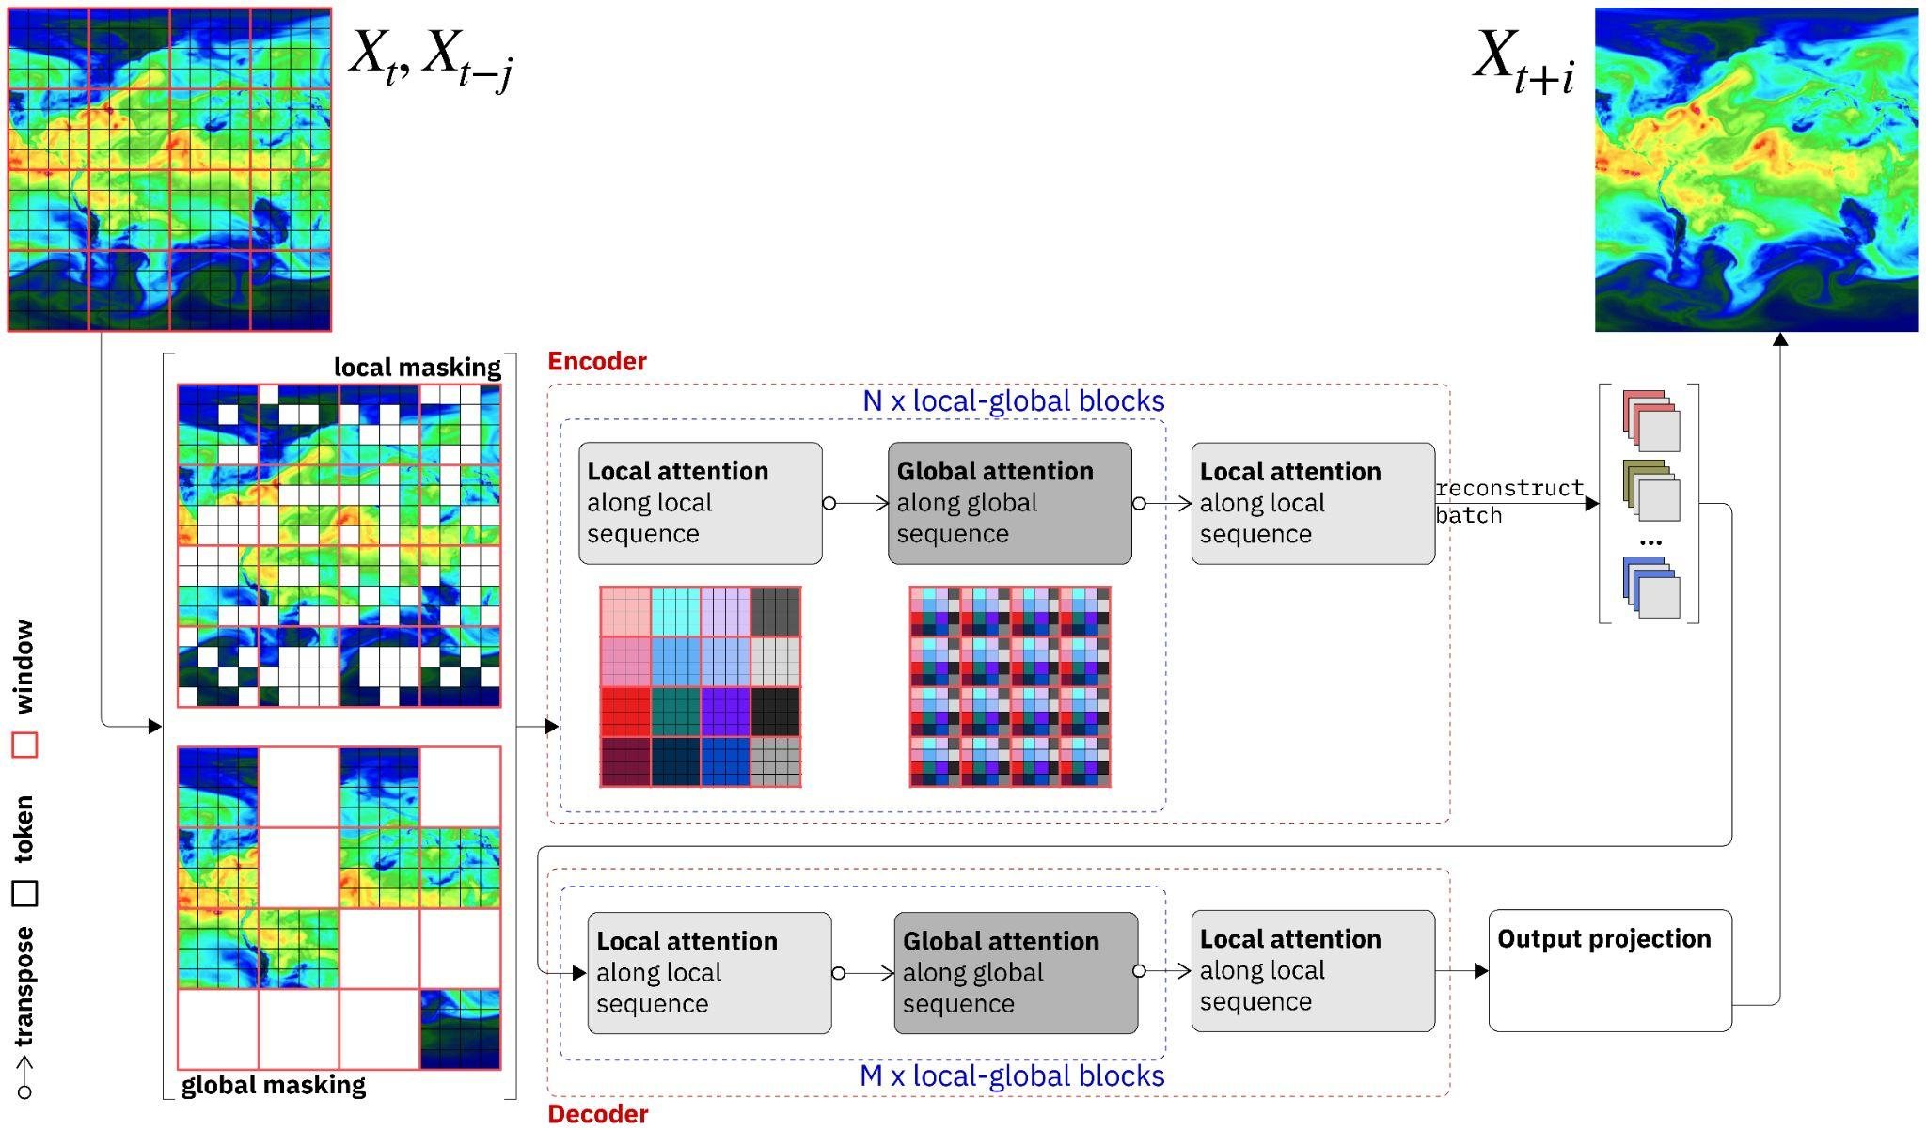
Examples
Component 1: Foundation Models for High-Value NASA Datasets
Prithvi-WxC (v1): TRL 7
Prithvi-EO (v1 and v2): TRL 9

Slide 20
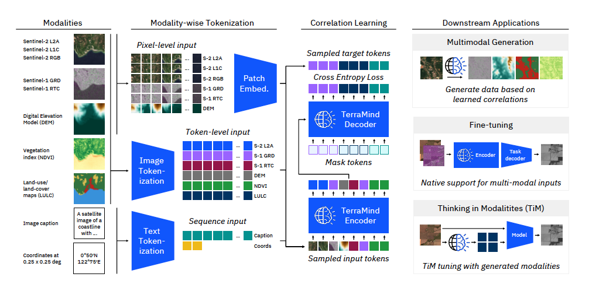
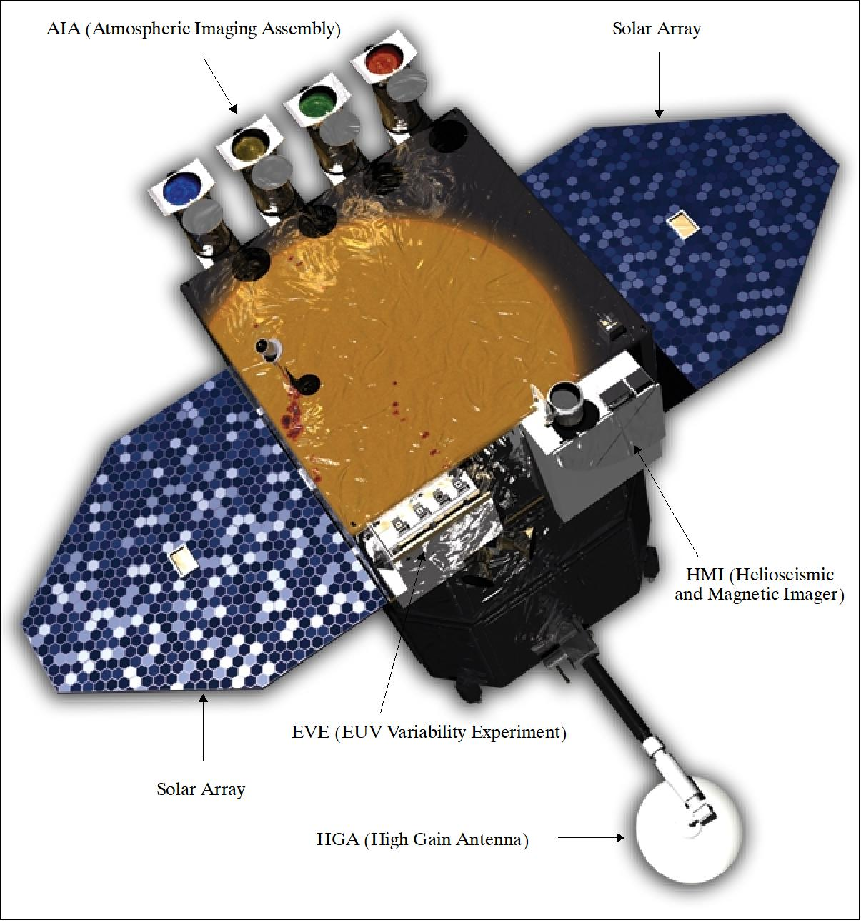
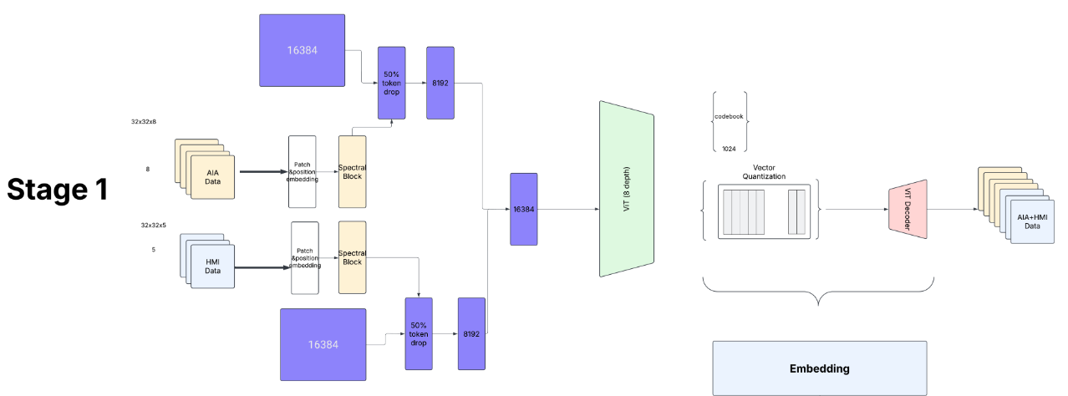
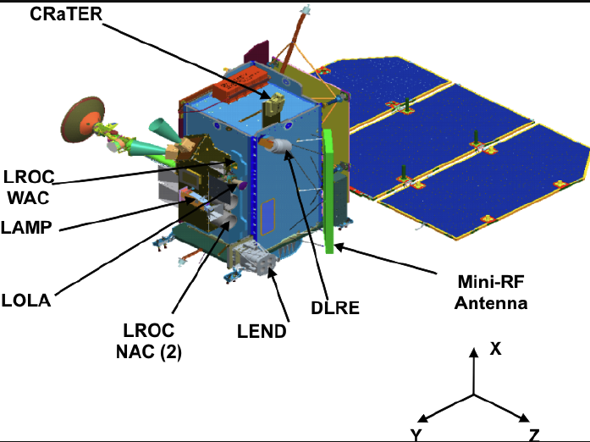
Examples
Component 2: Multimodal Foundation Models for Multi-Instrument/Mission Science
TerraMind* FM: TRL 6
IBM Research – Europe, ETH Zurich, Jülich Supercomputing Center, ESA Phi Labs and NASA
Sentinel-1, Sentinel-2, LULC, NDVI, DEM, geographic coordinates, and natural language captions.
Science Applications -Supports any-to-any generation of modalities, such as text-to-image generation, land-use segmentation, geolocation prediction, vegetation assessments, and caption generation.
Combining multiple modalities typically provides better performance than using any modality alone.
LRO FM: TRL 2
Helio FM v2: TRL 3
LROC NAC/WAC (Optical Camera), LOLA (Laser Altimeter), CRaTER (Radiation Telescope), LAMP (UV Spectrograph), LEND (Neutron Detector),Mini-RF (Radar)
Science Applications - Resource exploration (ice), Surface characterization, Radiation hazard, Landing site selection,
UVI (Ultraviolet Imager, part of AIA), HMI (Helioseismic and Magnetic Imager) AND EVE (Extreme Ultraviolet Variability Experiment): measures the Sun's full-disk spectral irradiance in the extreme ultraviolet (EUV) range
Science Applications - Coronal heating and Solar wind connections, Mechanisms of solar erupts, Evolution of solar activity

Slide 21


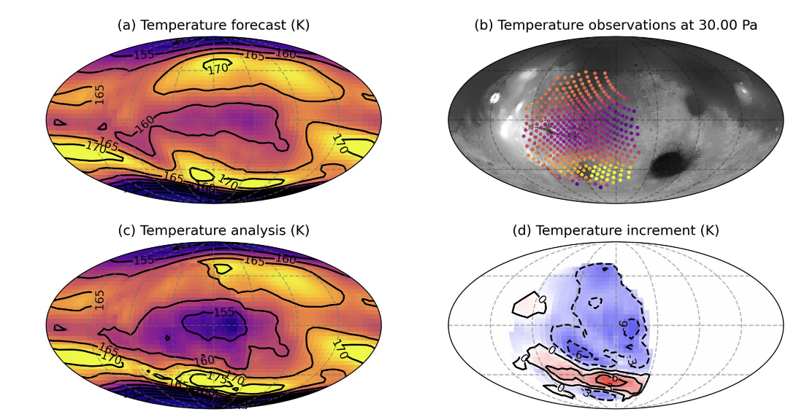
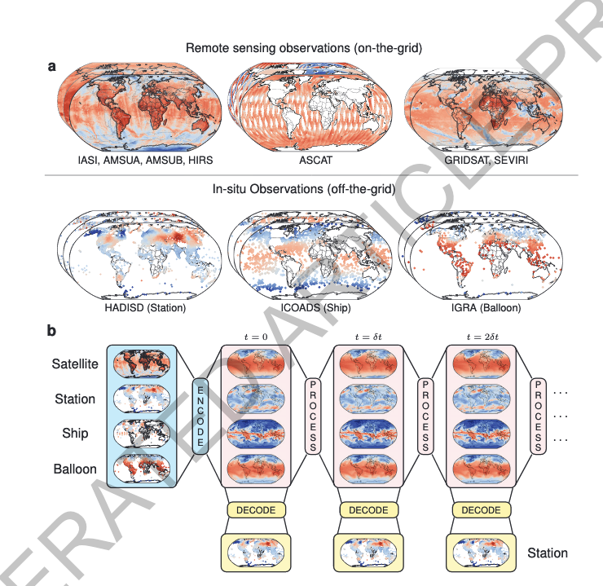
Examples
Component 3: Multi-Model AI
Young, Roland M. B., Ehouarn Millour, François Forget, Michael D. Smith, Mariam Aljaberi, Christopher S. Edwards, Nathan Smith, Saadat Anwar, Philip R. Christensen, and Michael J. Wolff. “First Assimilation of Atmospheric Temperatures From the Emirates Mars InfraRed Spectrometer.” Geophysical Research Letters 49, no. 21 (November 16, 2022): e2022GL099656. https://doi.org/10.1029/2022GL099656.
Allen, Anna, Stratis Markou, Will Tebbutt, James Requeima, Wessel P. Bruinsma, Tom R. Andersson, Michael Herzog, et al. “End-to-End Data-Driven Weather Prediction.” Nature, March 20, 2025. https://doi.org/10.1038/s41586-025-08897-0.
Mars Atmosphere FM: TRL 1
Prithvi FM* v2 (Data Assimilation): TRL 2
Demonstrated assimilation of atmospheric temperatures from the Emirates Mars Infrared Spectrometer (EMIRS) onboard Emirates Mars Mission (EMM) into the Mars Planetary Climate Model (PCM). (Traditional Assimilation method)
Can replace traditional assimilation with AI models (building on Prithvi-WxC knowledge)
Initiated scout team to develop a feasibility plan
FM for data assimilation that combines model and observations to make predictions

Slide 22
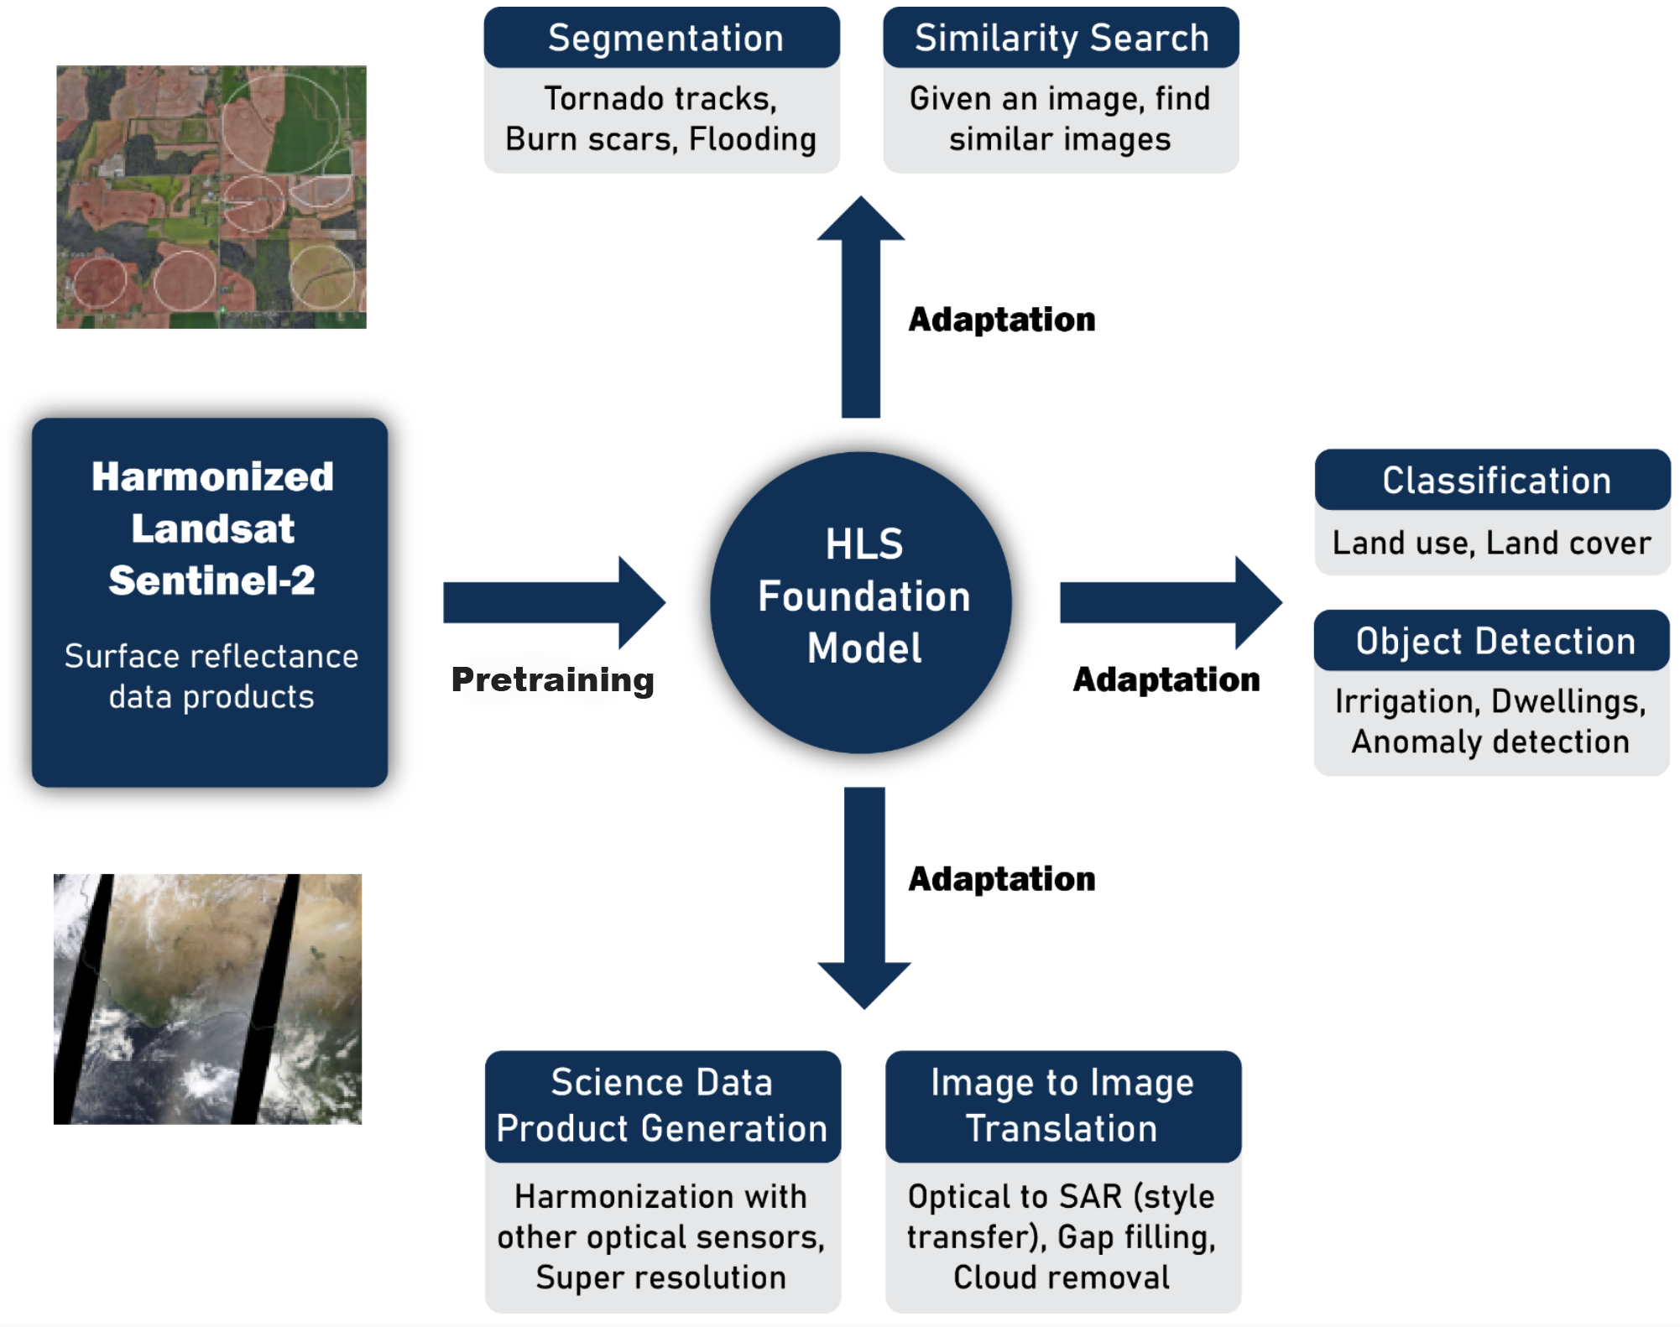
HLS Foundation Model (Prithvi-EO)
Collaboration with IBM Research
Initial version released are 100M and 300M parameter models
Masked Autoencoder where attention mechanism is extended in space and time
Being evaluated for adaptation for different categories of downstream tasks
Collaborators
IBM, UAH, Clark University, ORNL, Hugging Face

Slide 23
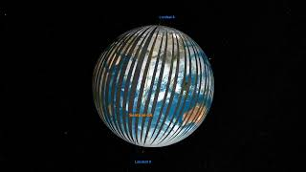
Why HLS?
Prithvi-EO
Video Credit: Scientific Visualization Studio
Merging Sentinel-2 and Landsat data
2-4 day global coverage
“Seamless” near-daily 30m surface reflectance
~8000 citations
2 PB+ data transferred to users
2nd most downloaded data from NASA Earth observation data archive

Slide 24
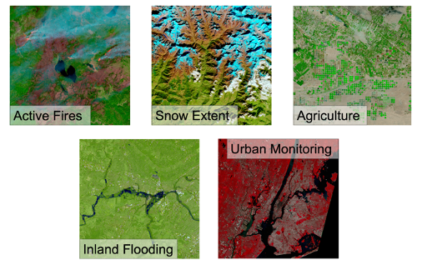
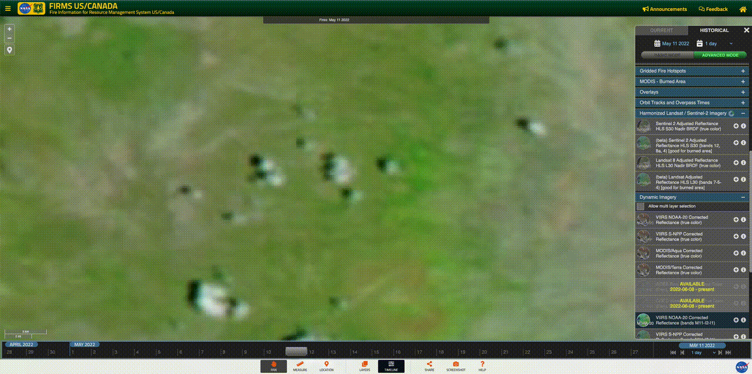
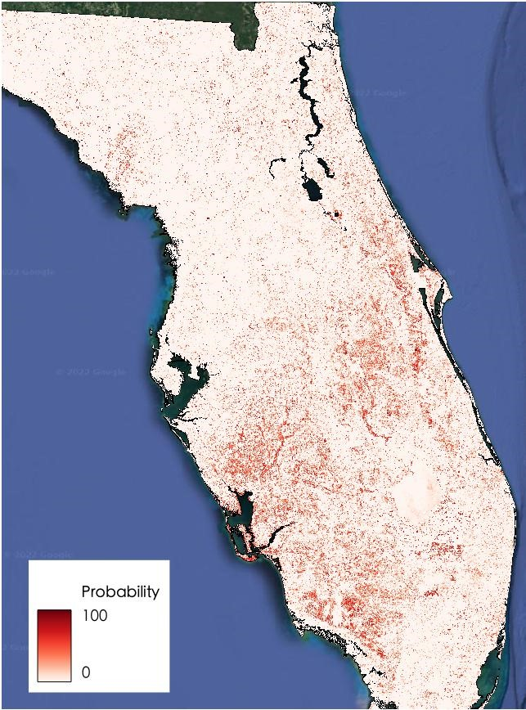
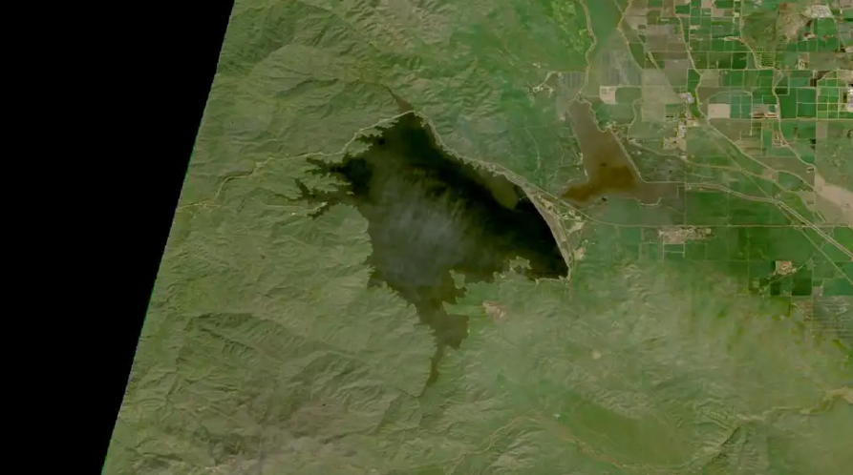
HLS applications
Wildfire monitoring in FIRMS.
Reservoir water level monitoring.
Assessing and reporting damage during Hurricane Ian.

Slide 25
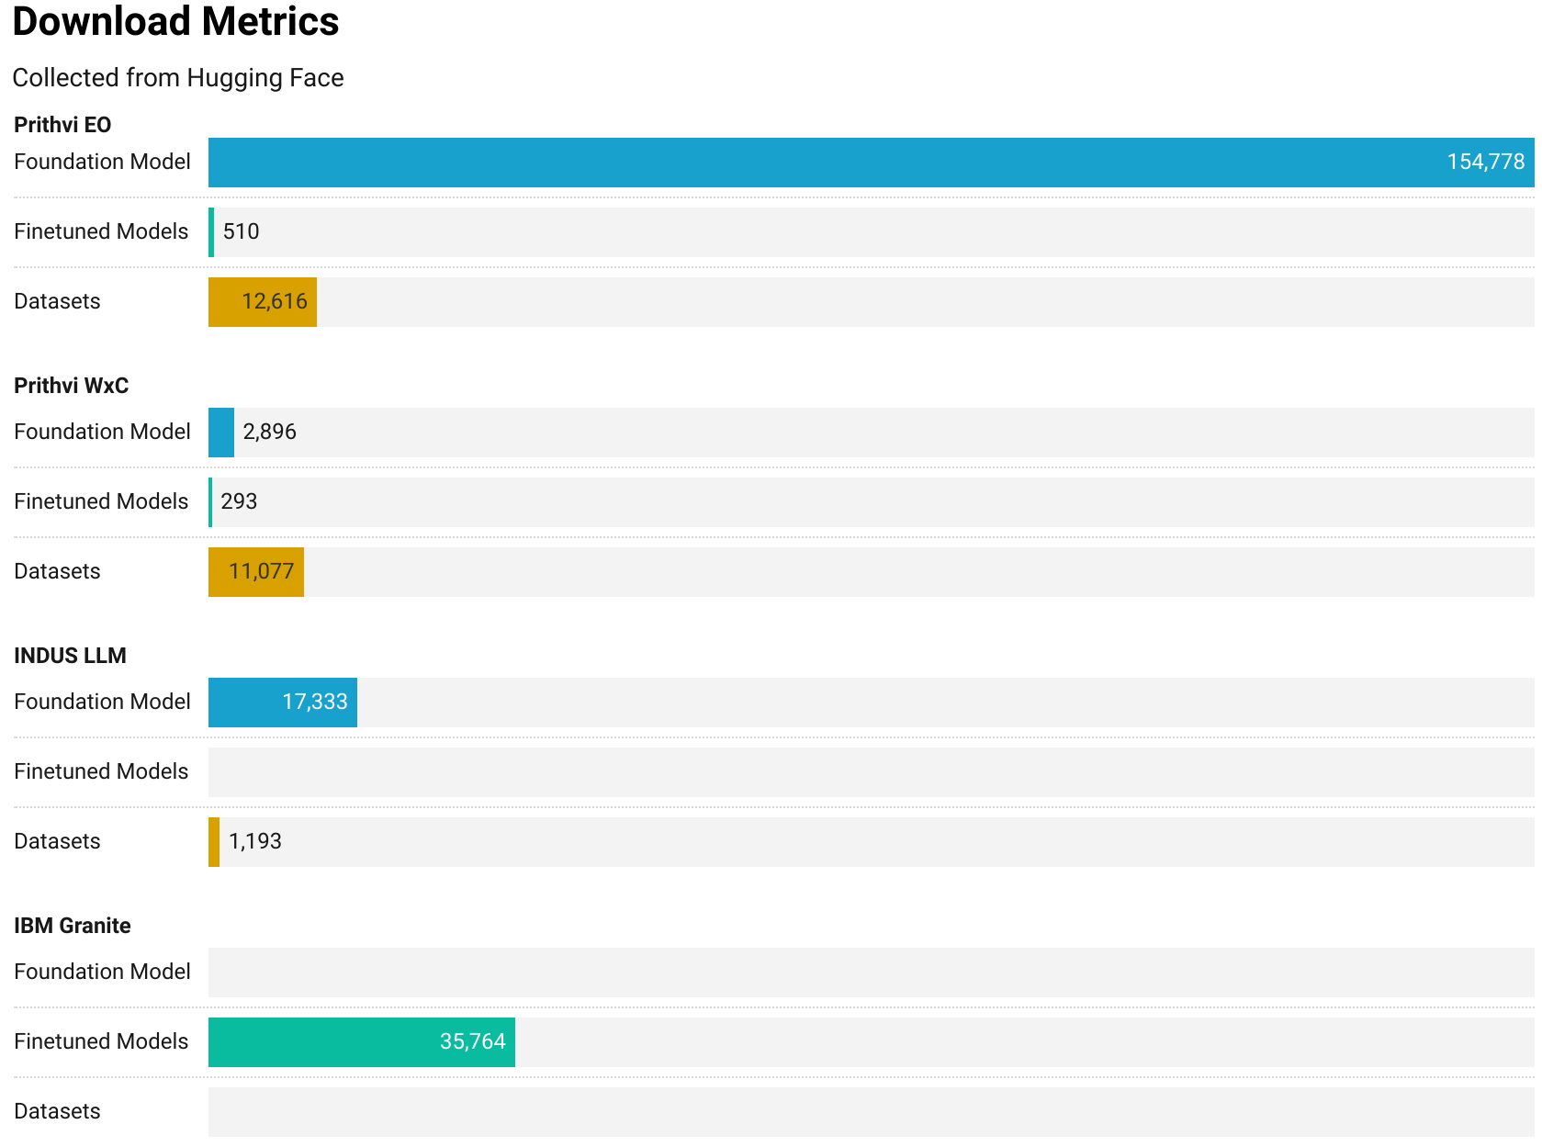
AI Foundation Model for Science
Download metrics

Slide 26
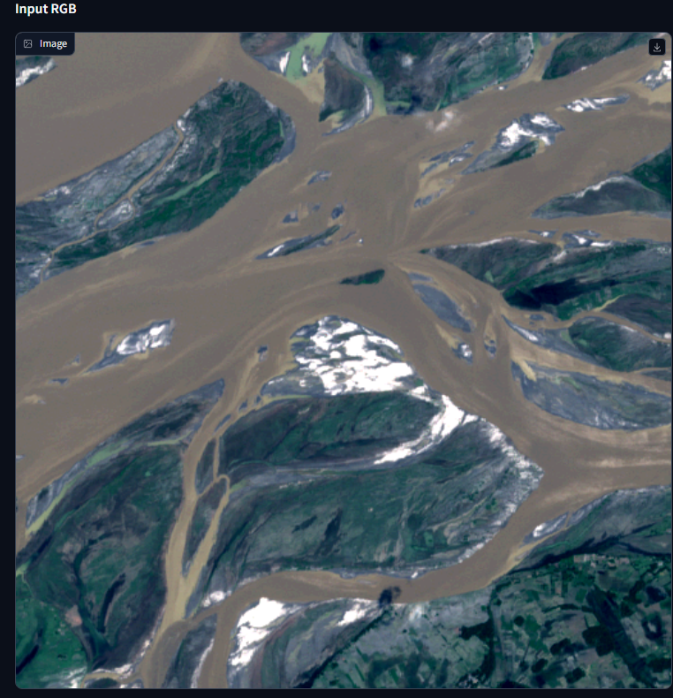
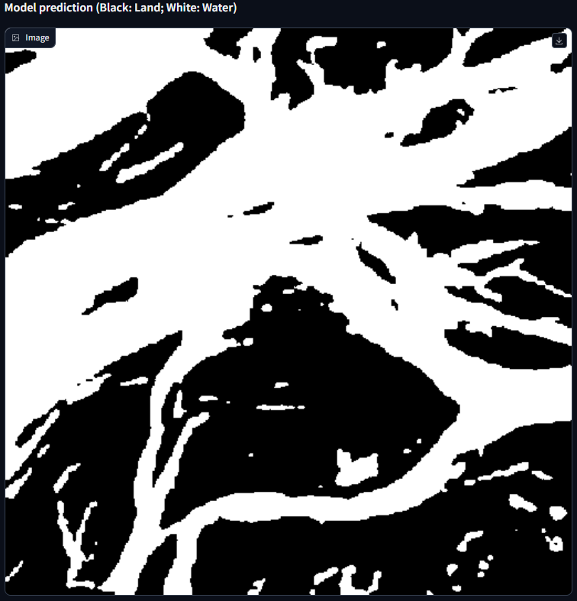
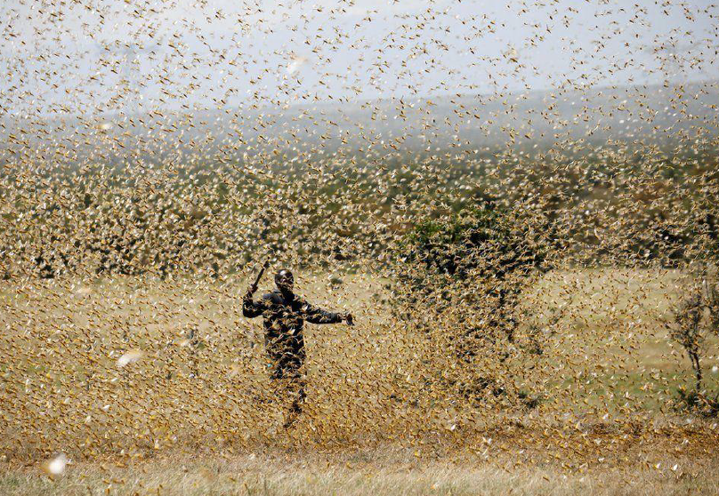
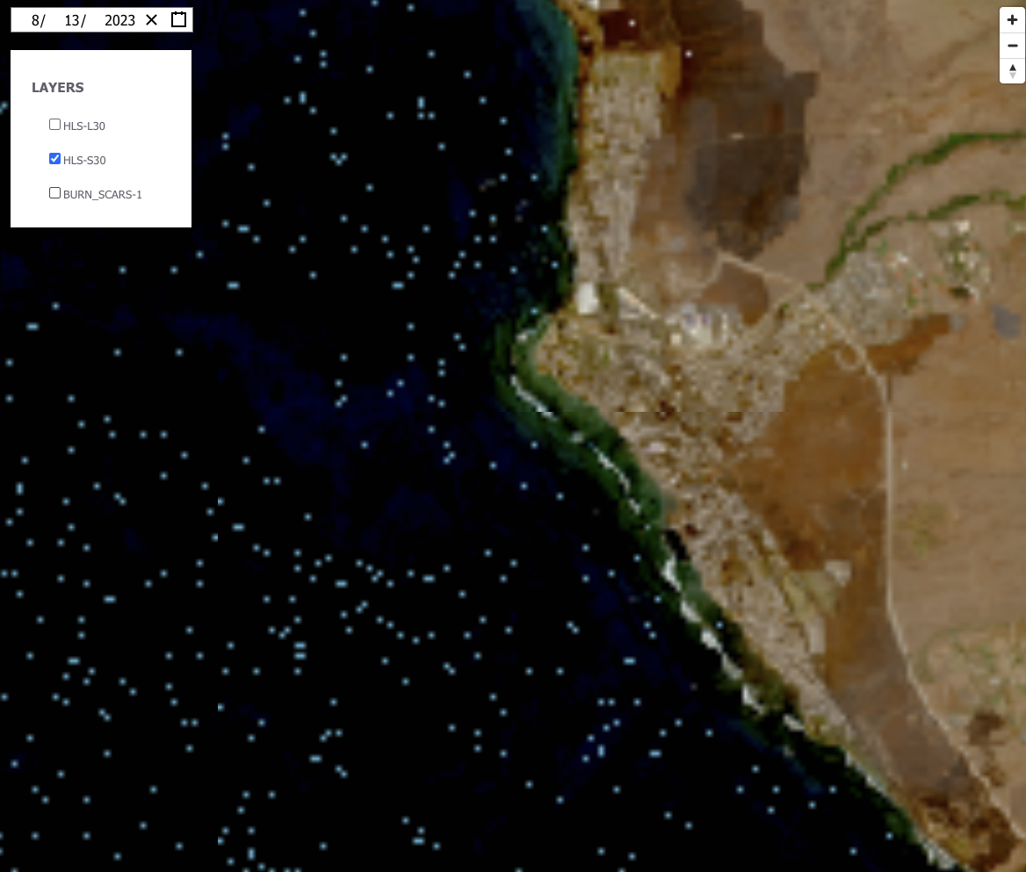
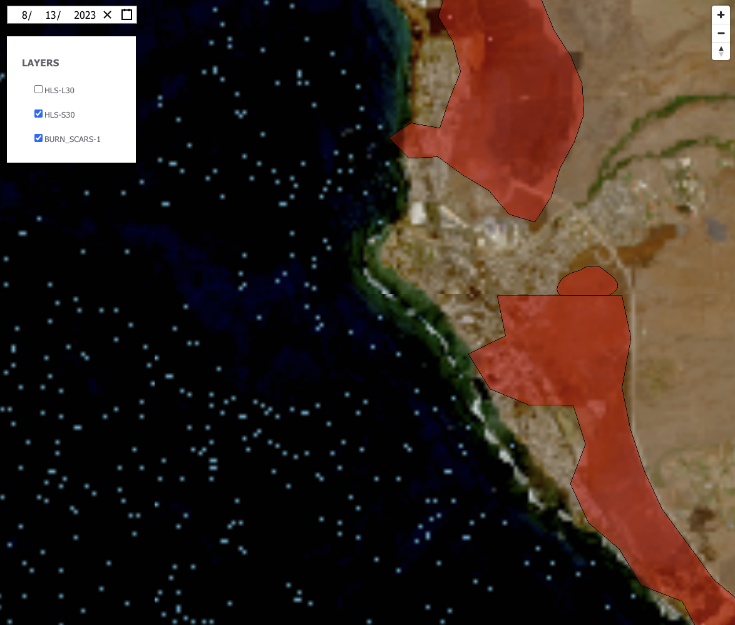
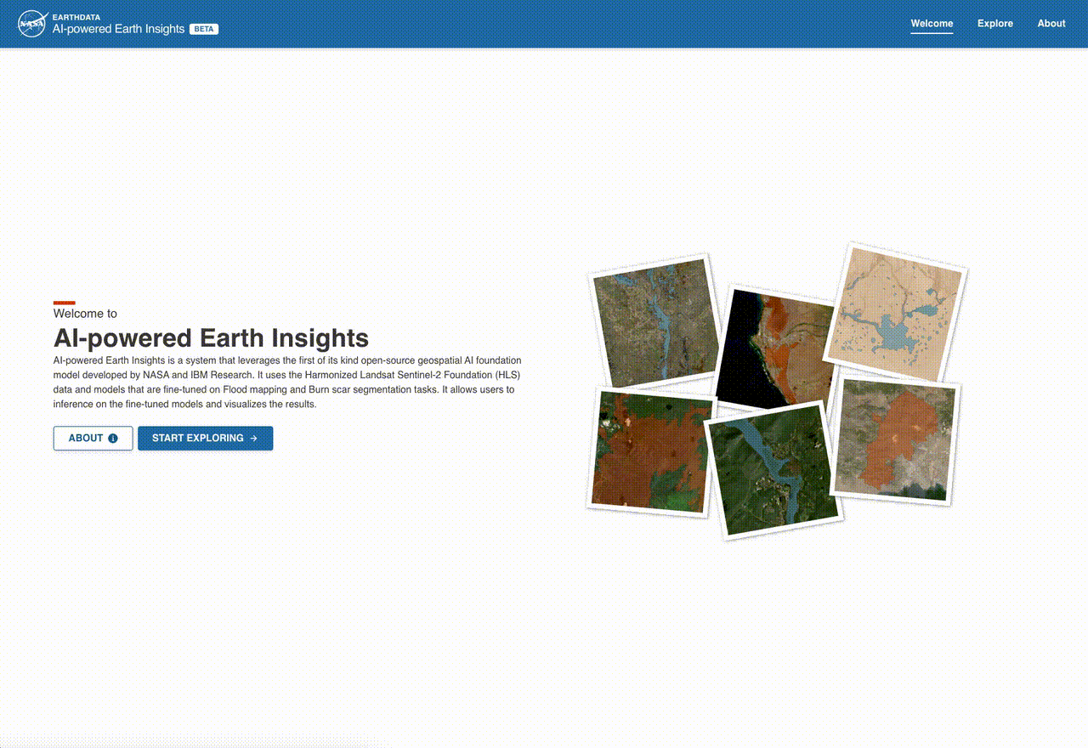
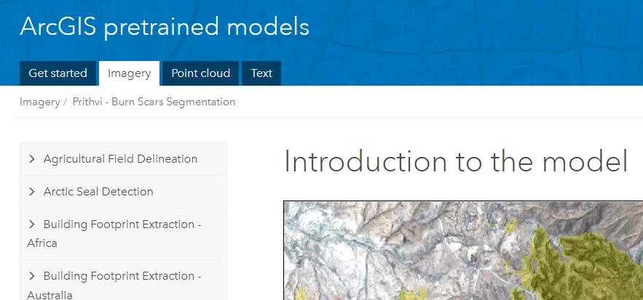
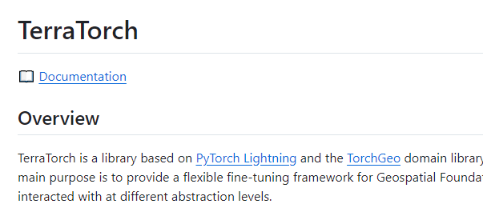
Prithvi EO Success Story
Applications
Reuse
Burn scar detection
Flood water delineation
Crop classification
Cloud gap filling
LULC (HK region)
Eddy covariance
Insect damage estimation
Locust breeding ground prediction
Semantic segmentation of mangrove forest
Model fine-tuned to segment the extent of floods on Sentinel-2
Locust breeding ground prediction
Source: Arnu Pretorius, Yusuf Ibrahim InstaDeep
NASA Data Systems Integration
Burn scar mapping: Maui Fire 8.13.2023
Industry Adoption
Community Developed Library
ESRI Living Atlas
(IBM)
Notes:
ESAC

Slide 27
Summary
Our principles
Open science
Core focus on science and applications
Early involvement of domain experts
Continuous evaluation of impact/values - benefits are multifaceted
Inclusion of multi-party stakeholders
Aim for extreme transparency - encourage participation and trust
Science Goals
Data
Compute
AI Foundational Expertise
Open Collaboration

Slide 28
Summary
Takeaways from tutorial: Expanding proficiency in science foundation models
Using FM to enhance research processes and scale analysis.
Establish a data science environment and conduct interactive analysis.
Develop a strong understanding in geospatial foundation models.
Apply a fine-tuned geospatial foundation model effectively.
Learn best practices to maximize potential of FMs.

Slide 29
Summary
We hope……
You learned something new. Something you didn't know before you came here and will challenge you to go back and learn more
You met a potential collaborator
You will have a good time

Slide 30


IEEE GRSS
Earth Science Informatics TC
HDCRS WG
Earth² WG
IBM Research
All the participants
Special thanks to:
Bianca Zadrozny, Iksha Gurung, Rocco Sedona
Thank you
manil.maskey@nasa.gov
Name
Bio
Something everyone else should think about

